Slide 1

Level 1 – Detailed/Logical Data Flow Diagram for 12.01 Generate Balance Sheet
Updated / Generated Balance Sheet Report Data
12.01 Generate Balance Sheet
Fetches Balance Sheet Report
User / Manager / Accountant
GL/Equity Data (DF-In)
Vendor/Liability Data (DF-In)
Cash/Bank Asset Data (DF-In)
Customer/Asset Data (DF-In)
04 – Financial Data Entry
05 – Bank Feeds and Reconciliations
07 – Accounts Receivable
11 – Accounts Payable

Slide 2
Level 1 – Detailed/Logical Data Flow Diagram for 12.02 Generate Income Statement (Profit & Loss)
Generated / Updated Income Statement (P&L) Report Data
User / Accountant
Fetches Income Statement (P&L) Report
12.02 Generate Income Statement (Profit & Loss)
Revenue Data (DF-In)
Operating Expense Data (DF-In)
Cost/Expense Data (DF-In)
06. Invoicing
09. Expense Claims
10. Bills to Pay

Slide 3
Level 1 – Detailed/Logical Data Flow Diagram for 06.01 Create Invoice
02. User Management
New/ Updated Invoice
User
06. 01 Create Invoice
Invoice Settings
Customer master data
03. Settings & Configuration
DF-Out: New/Updated
Invoice
DF-In: Chart of Accounts
12. Accounting Reports
07. Accounts Receivable
104. Financial Data Entry

Slide 4
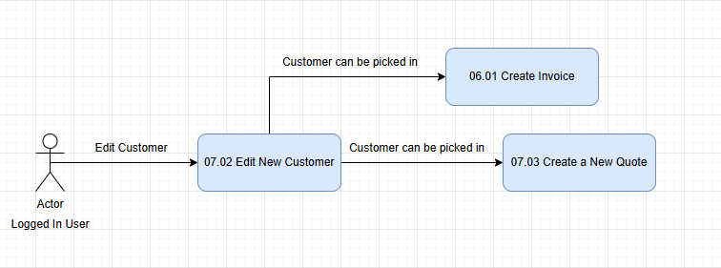
Data Flow Out - Customer is visible while creating new Quote/Invoice

Slide 5
Data Flow Out - Modified Customer details are visible in Create new Invoice and Create new Quote modules

Slide 6
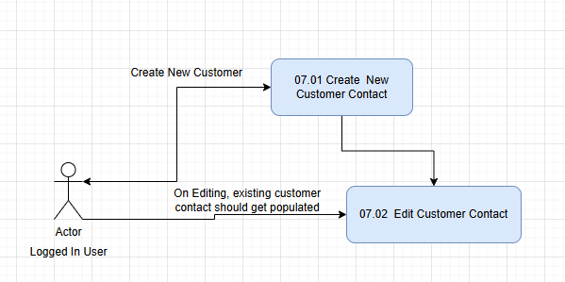
Data Flow In - Existing customer get auto populated

Slide 7
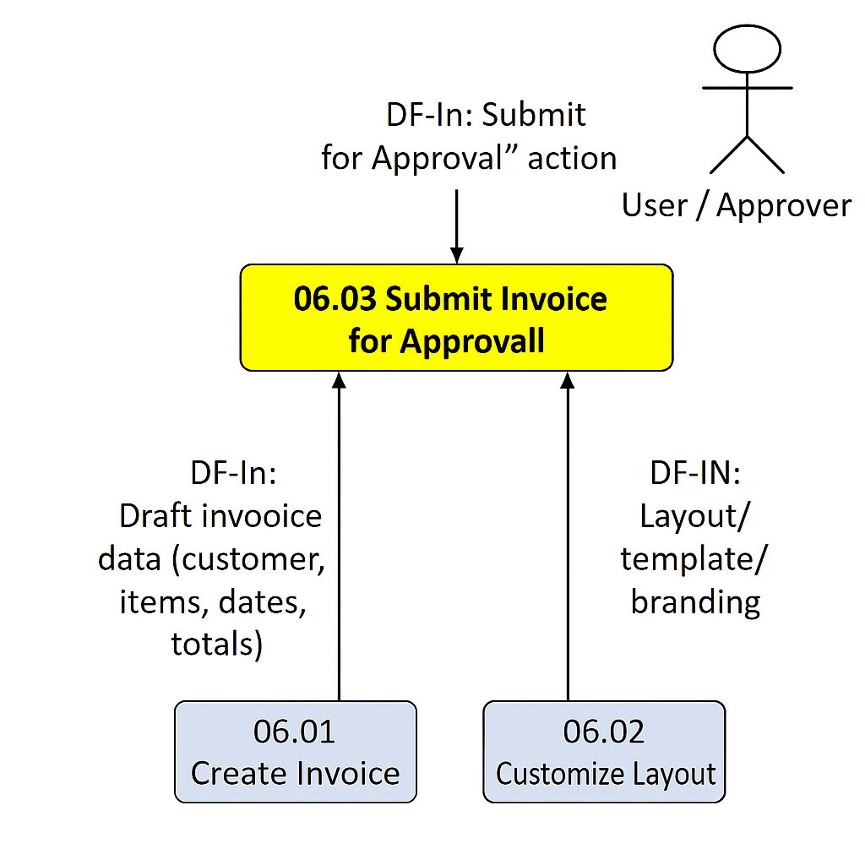
Data Flow In – Draft invoice details and layout settings flow into the Submit Invoice for Approval process.

Slide 8
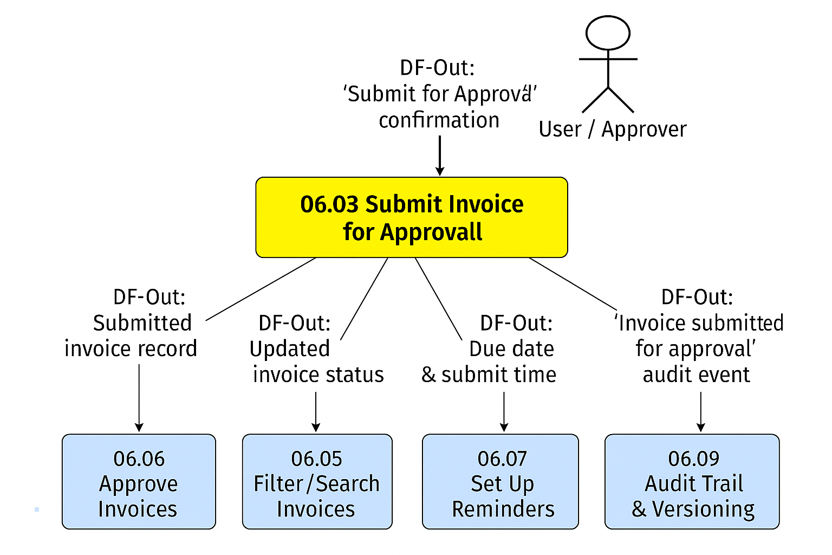
Data Flow Out – Submitted invoice details become visible in approval, search, reminder, and audit modules.

Slide 9
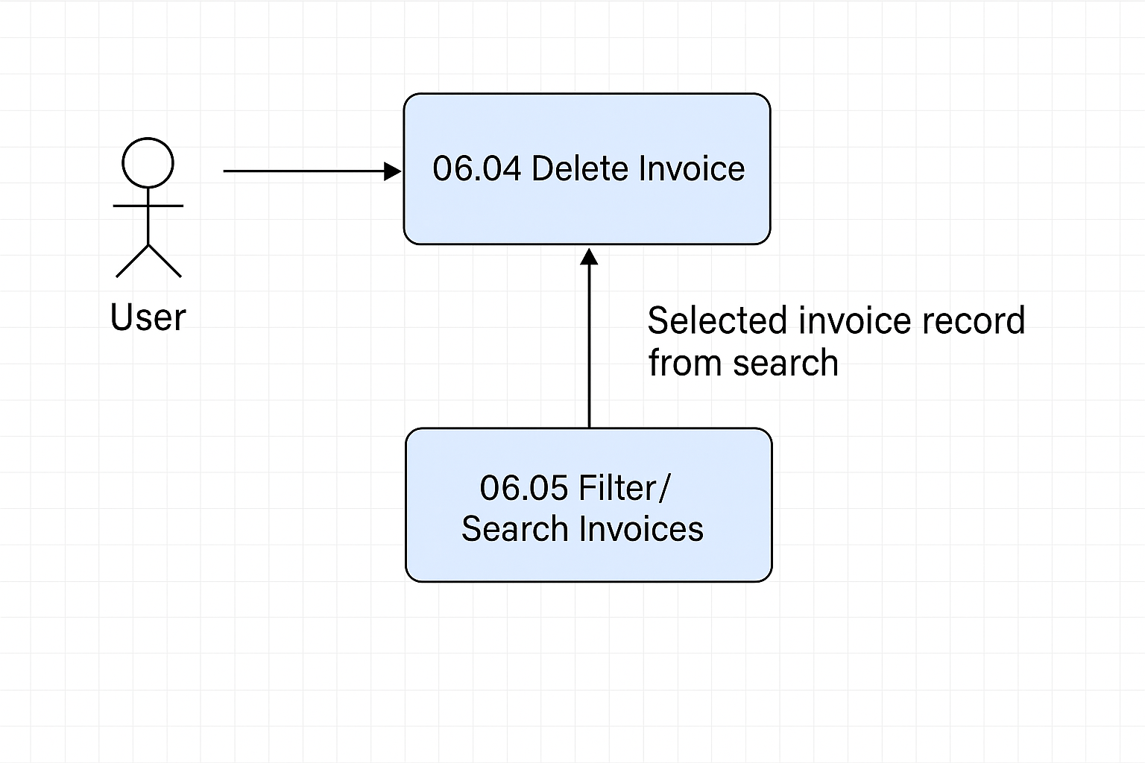
Data Flow In – The user selects an invoice from search and sends it to the Delete Invoice module.

Slide 10
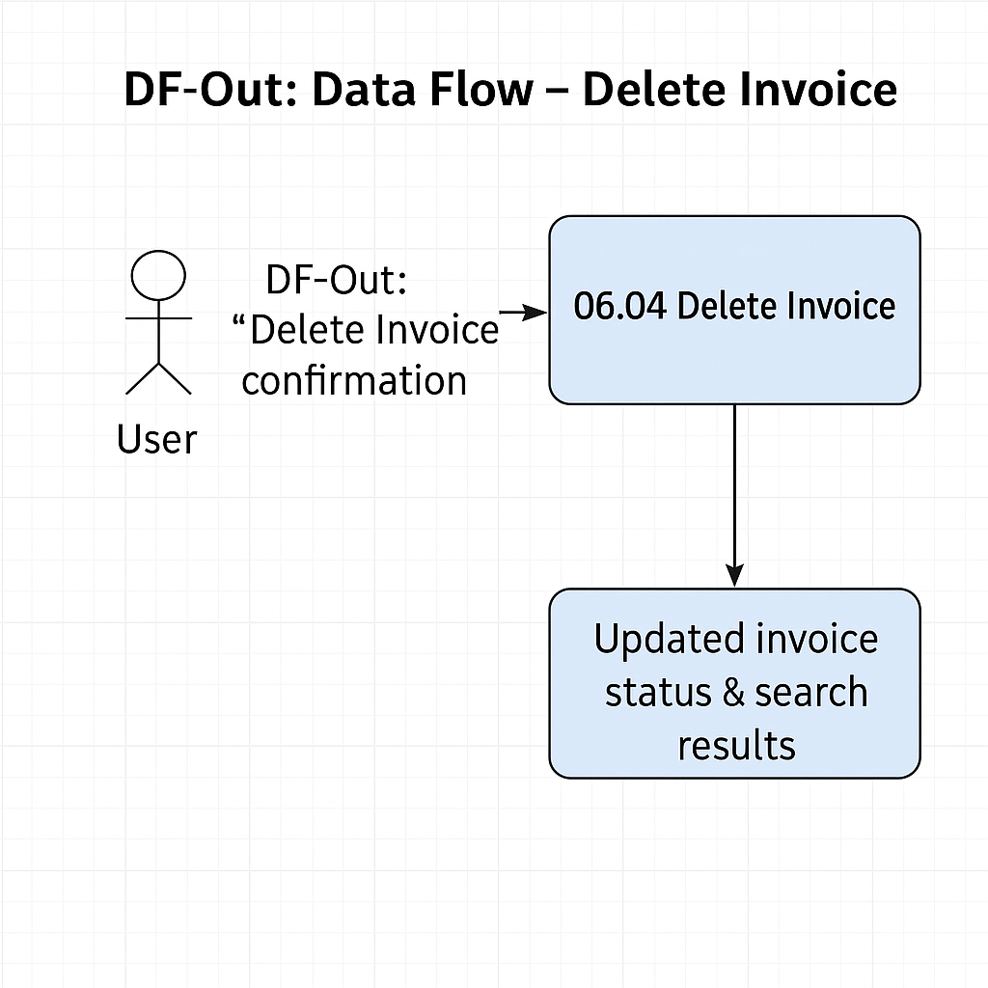

Slide 11
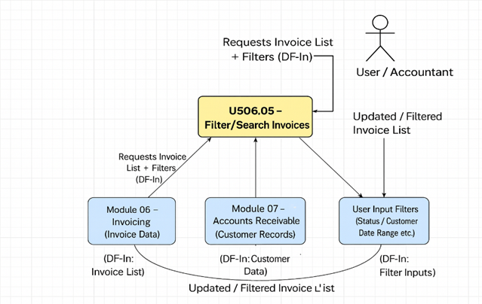
Data Flow diagram for search results fetch the latest invoice data from the system

Slide 12
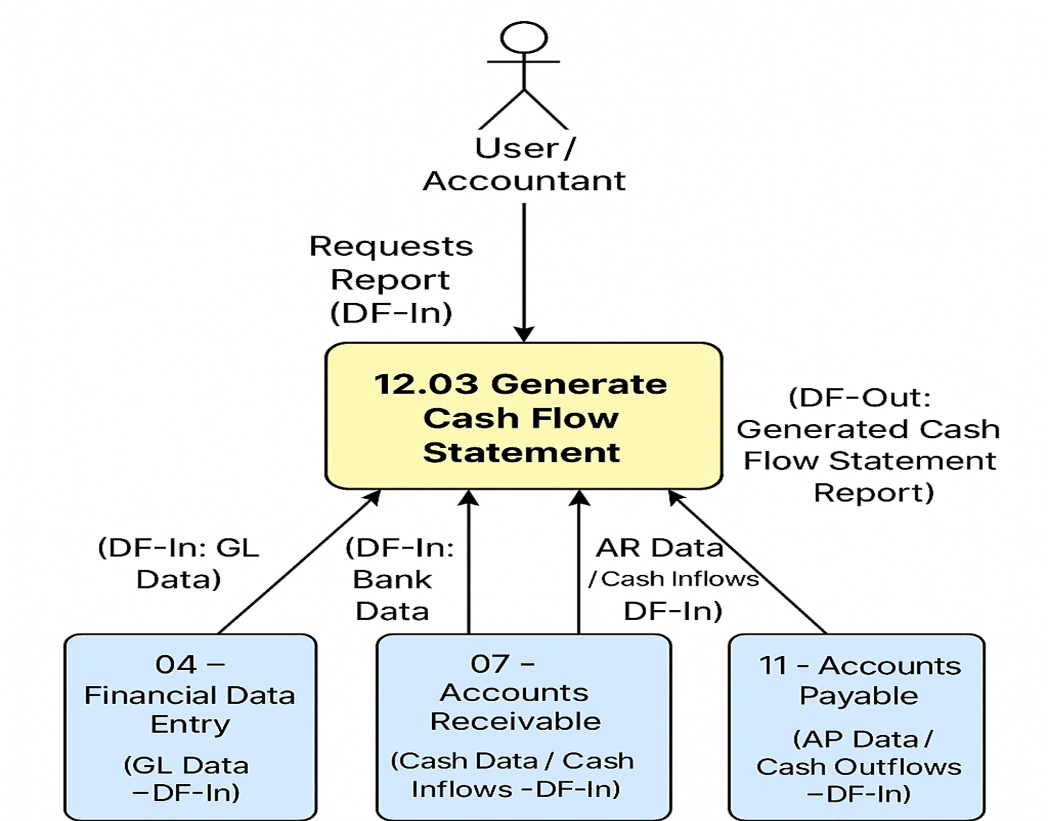
Data Flow Diagram For Generate Cash Flow Statement

